Slide 1
Caches
Titov Alexander
13.03.2010

Slide 2
Classic components of a computer
Computer
control
memory
output
datapath
processor
input

Slide 3
The city example (spatial locality)
Factory
Your shop
Shop store
Large storehouse
Storehouse
The delay is decreased, but the cost is increased

Slide 4
The bookshelf example (temporal locality)
Your bookshelf
A-B | C-D | E-F | G-H | I-J | … | … | … | … | … | Y-Z
Places for books
The first latter in the name of the author
fast
slow
City Library
Your table

Slide 5
Simple direct mapped cache
000
001
010
011
100
101
110
111
index
Index length = log2(number of cache block)
Cache capacity is 8 = 2³ , therefore the index takes 3 bites
Cache
data
Main memory
data
00001
00101
01001
01101
10001
10101
address

Slide 6
Simple cache scheme
31 30 29 . . . . . . . . . . . . 12 11 10 9 8 . . . . . . 3 2 1 0
Address
Physical address tag
Cache index
Byte offset
16
12
2
Index
Valid
Tag
Data
0
1
2
…
…
1022
1023
Cache hit
=
32
Data

Slide 7
Associativity
Index length = log2(number of cache block/number of ways)
Direct mapped cache
2-way set-associative
Fully associative cache
data
000
data
data
index
set
index
set
index
set
001
1
00
1
010
2
00
011
3
01
2
1
100
4
01
101
10
Not used
5
3
110
6
10
111
7
11
11
4
8
The miss rate is decreased, but hit time, size, power are increased

Slide 8
Associativity and bookshelf
Direct bookshelf
A-B | C-D | E-F | G-H | I-J | … | … | … | … | Y-Z
Only one place for a book
Two-way set-associative bookshelf
A-D |  | E-F |  | … |  | … |  | W-Z
Only two place for a book
Full associative bookshelf
Any place are available for a book

Slide 9
A four-way set-associative cache
31 30 29 . . . . . . . . . . . . 12 11 10 9 8 . . . . . . 3 2 1 0
Address
Physical address tag
Cache index
Byte offset
22
8
2
Tag
Data
Index
Tag
Data
V
V
Tag
Data
Tag
Data
V
V
0
1
2
…
…
254
255
32
=
=
=
=
multiplexor
OR
32
Hit
Data

Slide 10
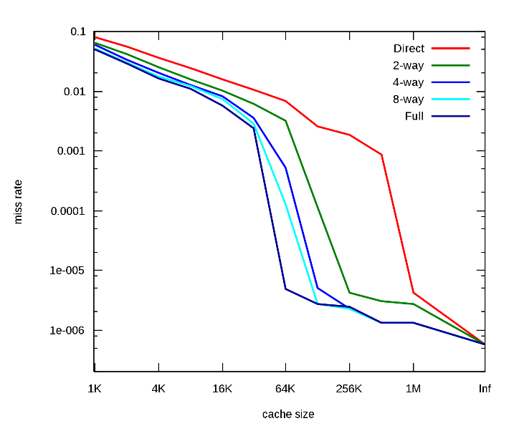
Miss rate diagram
Capacity misses
Conflict
Compulsory
Compulsory misses. They are caused by the first reference to the data.
Capacity misses (due to cache capacity limitation only)
Conflict misses:
  Mapping misses (cache is not fully associative)
  Replacement misses (the replacement policy is not ideal)

Slide 11
Writes handling
There is no write into the instruction cache.
In the most of modern systems the cache block is larger than store data, thus only the part of the cache block is updated.
Hit/miss logic is very similar to one in cache read.
Write request
Locate block using index
No
Is tag equal?
Yes
Write miss
Load block from the next level of hierarchy into the cache
Write hit
Write the data into the cache block

Slide 12
Inconsistence handling
After writing into the cache, memory would have a different value from that in the cache (cache and memory are inconsistent). There are two main ways to avoid it:
  Write-trough. A scheme in which writes always update both the cache and the memory, ensuring that data is always consistent between the two.
  Write-back. A scheme that handles writes by updating values only to the block in the cache, then writing the modified block the lower level of the hierarchy when the block is replaced

Slide 13
Write-through vs write-back
The key advantages of write-back:
  Individual words can be written by the processor at the rate that the cache, rather then the main memory, can accept them.
  Multiple writes within a block require only one write to the lower level in the hierarchy.
Ones of write-through:
  Evictions of a block from the cache are simpler and cheaper because they never require a block to be written back to the lower level of the memory hierarchy.
  Write-through is easier to implement than write-back

Slide 14
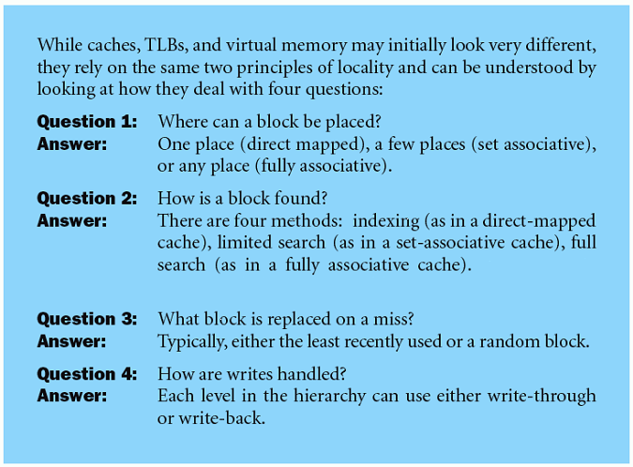
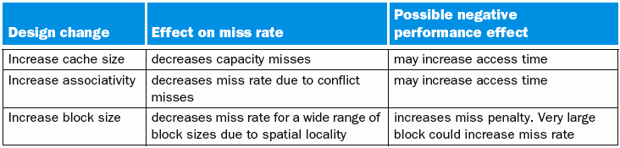
Small summary

Slide 15
Improving Cache Performance
Rates:
  Miss Rate = Misses / total CPU request
  Hit Rate = Hits / total CPU request = 1 – Miss Rate
Goal: reduce the Average Memory Access Time (AMAT):
  AMAT = Hit Rate * Hit Time + Miss Rate * Miss Penalty
  But HitRate ≈ 0.9, HitTime ≈ 10 clk, MissRate ≈ 0.1, MissPenalty ≈ 200 clk, then
  AMAT ≈ Hit Time + Miss Rate * Miss Penalty
Approaches:
  Reduce Hit Time
  Reduce Miss Penalty
  Reduce Miss Rate
Notes:
  There may be conflicting goals
  Keep track of clock cycle time, area, and power consumption

Slide 16
Tuning Basic Cache Parameters:
Size, Associativity, Block width
Size:
  Must be large enough to fit working set (temporal locality)
  If too big, then hit time degrades
Associativity:
  Need large to avoid conflicts, but 4-8 way is as good as FA (full associative)
  If too big, then hit time degrades
Block:
  Need large to exploit spatial locality & reduce tag overhead
  If too large => cache has few blocks => higher miss rate & miss penalty
Hit rate
≈4
Size
Associatively
Block width

Slide 17
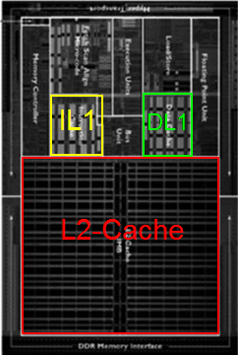
Multilevel caches
AMD Opteron
Motivation:
  Optimize each cache for different constraints
  Exploit cost/capacity trade-offs at different levels
L1 caches
  Optimized for fast access time (1-3 CPU cycles)
  8KB-64KB, DM to 4-way SA
L2 caches
  Optimized for low miss rate (off-chip latency high)
  256KB-4MB, 4- to 16-way SA
L3 caches
  Optimized for low miss rate (DRAM latency high)
  Multi-MB, highly associative
Processor
L1-instr
L1-data
L2-cache
L3-cache

Slide 18
2-level Cache Performance Equations
L1 AMAT = HitTimeL1 + MissRateL1 * MissPenaltyL1
  MissLatencyL1 is low, so optimize HitTimeL1
MissPenaltyL1 = HitTimeL2 + MissRateL2 * MissPenaltyL2
  MissLatencyL2 is high, so optimize MissRateL2
  MissPenaltyL2 = DRAMaccessTime + (BlockSize/Bandwidth)
  If DRAM time high or bandwidth high, use larger block size
L2 miss rate:
  Global: L2 misses / total CPU references
  Local: L2 misses / CPU references that miss in L1
  The equation above assumes local miss rate
HitTimeL2
DRAM
DRAMaccessTime is time to find block in DRAM
HitTimeL1
L2-Cache
BlockSize/Bandwidth
CPU
L1-Cache
Bandwidth – how many bytes can be transacted from DRAM per cycle

Slide 19
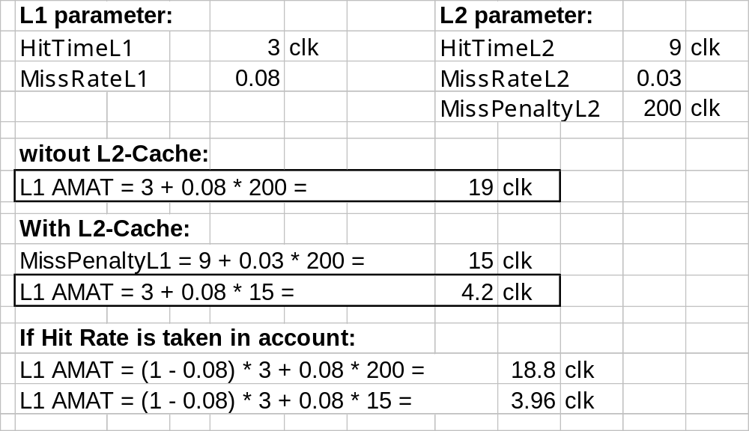
Improvement of AMAT for 2-level system

Slide 20
Reduce Cache Hit Time
Techniques we have seen so far (most interesting for L1)
  Smaller capacity
  Smaller associativity
Additional techniques
  Wide cache interfaces
  Pseudo-associativity
Techniques that increase cache bandwidth (number of concurrent accesses)
  Pipelined caches
  Multi-ported caches
  Multi-banked caches

Slide 21
Reduce Miss Rate
Techniques we have already seen before
  Larger caches
    Reduces capacity misses
  Higher associativity
    Reduces conflict misses
  Larger block sizes
    Reduces cold misses
Additional techniques
  Skew associative caches
  Victim caches

Slide 22
Victim Cache
Small FA cache for blocks recently evicted from L1
  Accessed on a miss in parallel or before the lower level
  Typical size: 4 to 16 blocks (fast)
Benefits
  Captures common conflicts due to low associativity or ineffective replacement policy
  Avoids lower level access
Notes
  Helps the most with small or low-associativity caches
  Helps more with large blocks
Cache
Victim
Cache
Lower level

Slide 23
Reducing Miss Penalty
Techniques we have already seen before:
  Multi-level caches
Additional techniques
  Sub-blocks
  Critical word first
  Write buffers
  Non-blocking caches

Slide 24
Sub-blocks
Idea: break cache line into sub-blocks with separate valid bits
  But the still share a single tag
Low miss latency for loads:
  Fetch required subblock only
Low latency for stores:
  Do not fetch the cache line on the miss
  Write only the sub-block produced, the rest are invalid
  If there is temporal locality in writes, this can save many refills

Slide 25
Write buffers
CPU/Cache L1
Cache L1/Cache L2
stores
Write buffers allow for a large number of optimizations
Write through caches
  Stores don’t have to wait for lower level latency
  Stall store only when buffer is full
Write back caches
  Fetch new block before writing back evicted block
CPUs and caches in general
  Allow younger loads to bypass older stores

